Slide 1
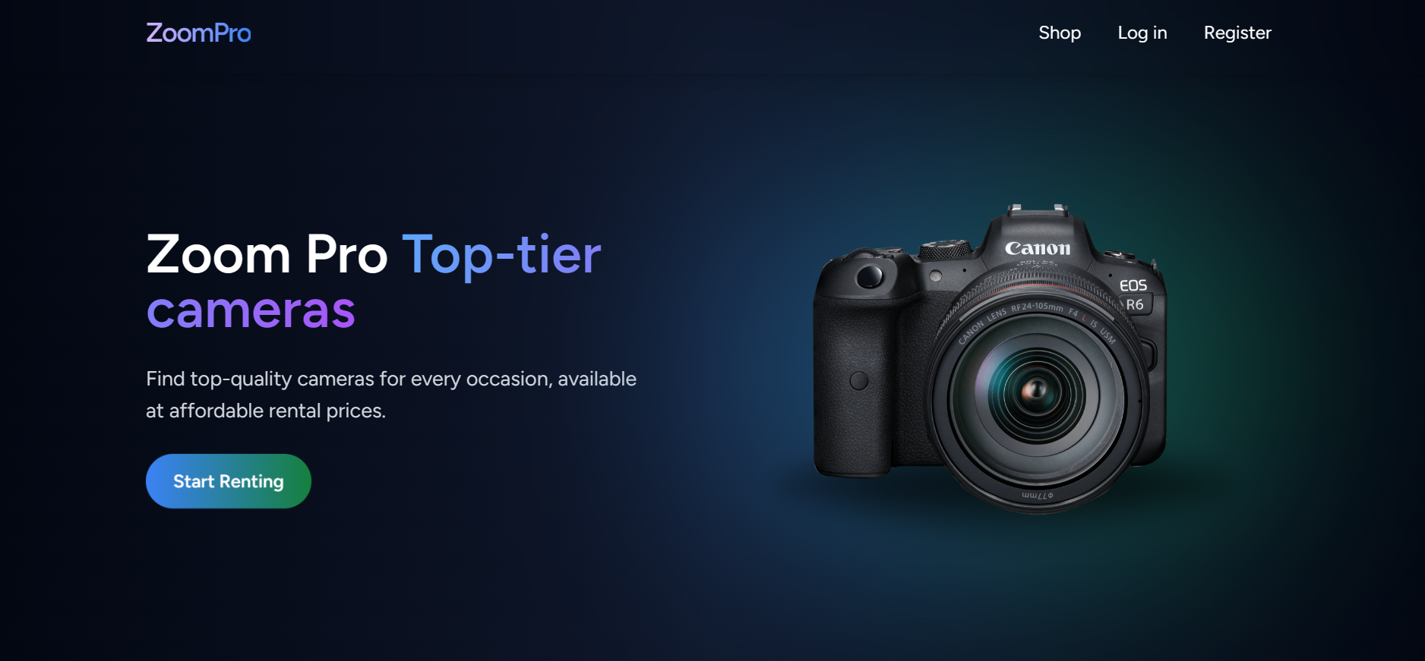



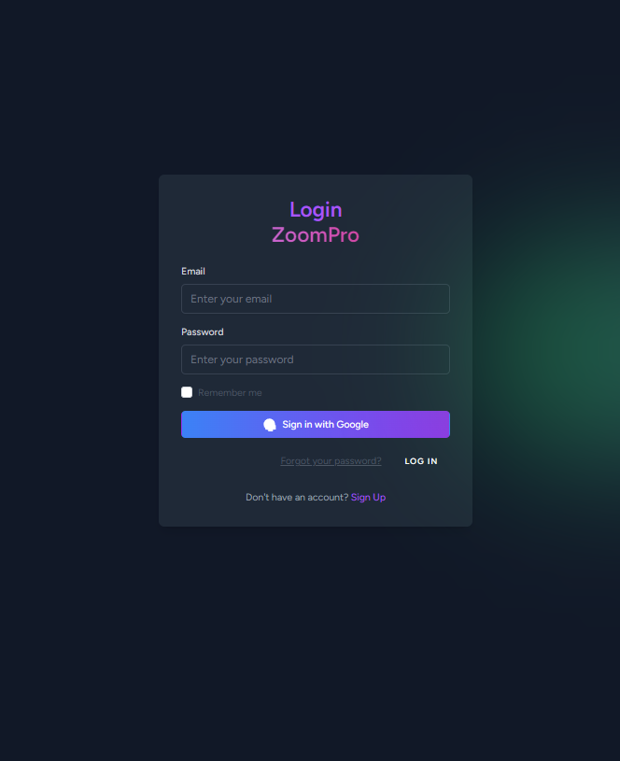

CAMERA
RENTAL
IT 108
Presented by:
Dave Jason B. Salte
Andre G. Salvador
Jeffrey Romerosa

Slide 2


01
PROBLEM STATEMENT
Renting cameras can be inconvenient, and there's a lack of streamlined online systems for managing rentals.
Without an online platform, renters face challenges such as time-consuming searches, unclear pricing and availability, and inefficient booking processes.

Slide 3

02
GOALS & OBJECTIVES
User-friendly
Provide a user-friendly platform to rent cameras.
Enable role-based access for customers, employees and admins.
Customer Convenience
Simplify payment calculations. Streamline rental and management workflows.

Slide 4


03
The Camera Rental System is a web-based application designed to streamline the process of renting cameras.
PROJECT
CONCEPT
It allows customers to browse available cameras, select a unit for rental, and process payments efficiently.
The system implements Role-Based Access Control (RBAC) to manage permissions and ensure secure access for different user roles.

Slide 5

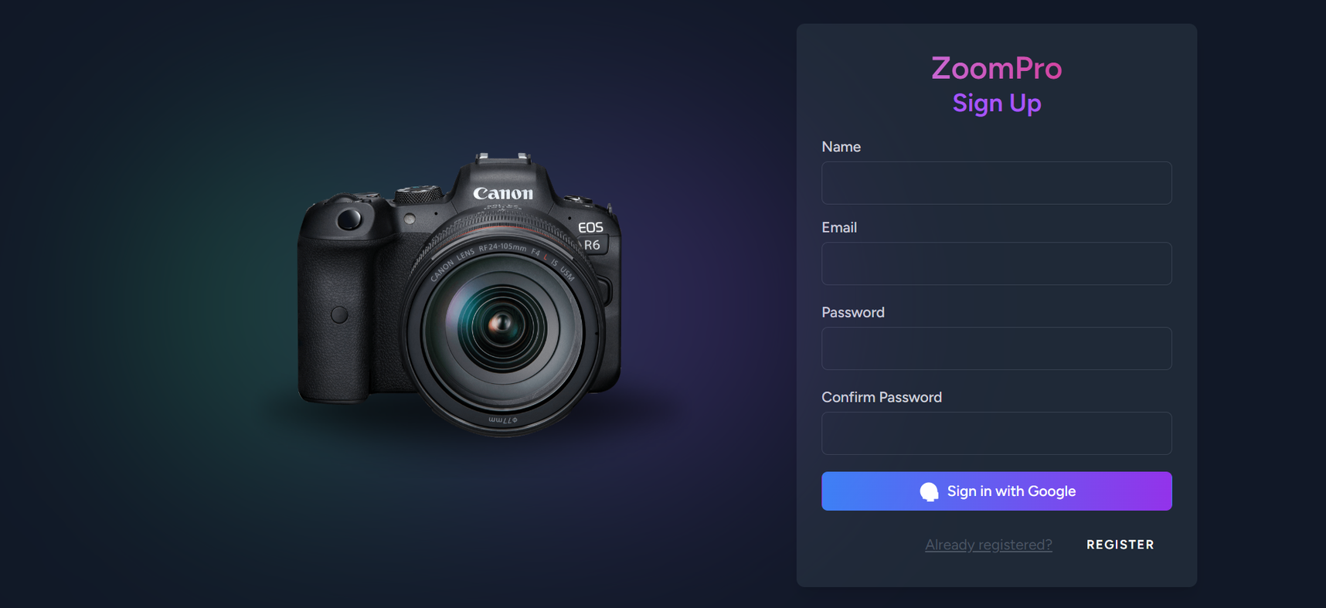

CRUD
CREATE
04
Users can create an account by navigating to the registration page and providing their name, email address, and password to complete the sign-up process.

Slide 6
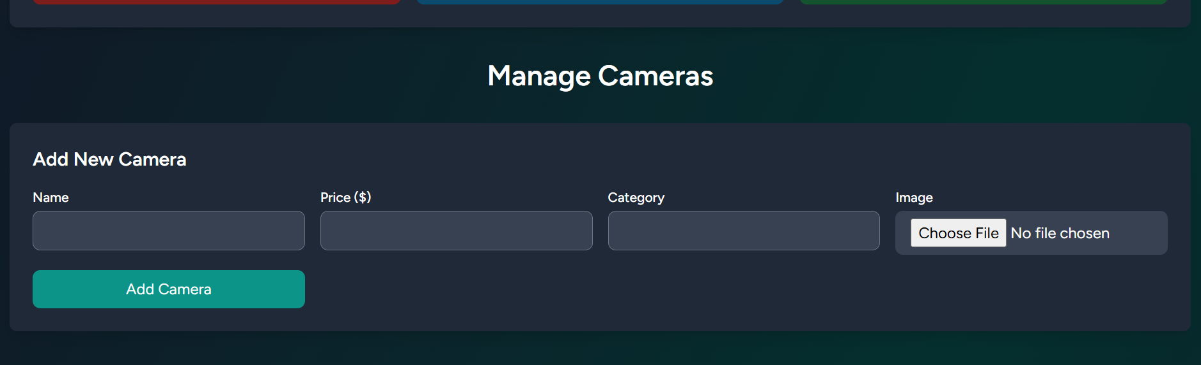
CRUD
CREATE
04
The manager can add a new camera unit through the Camera Dashboard page by providing the camera's name, price, category, and image.

Slide 7
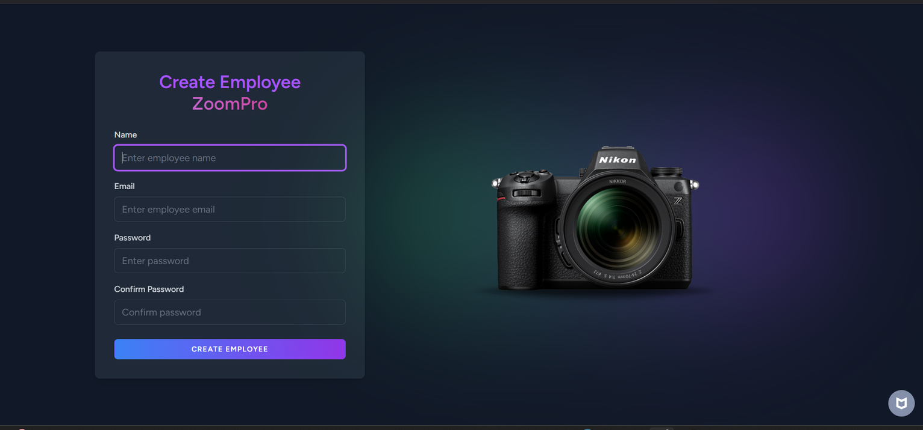
CRUD
CREATE
04
The manager can create account of the employees.

Slide 8
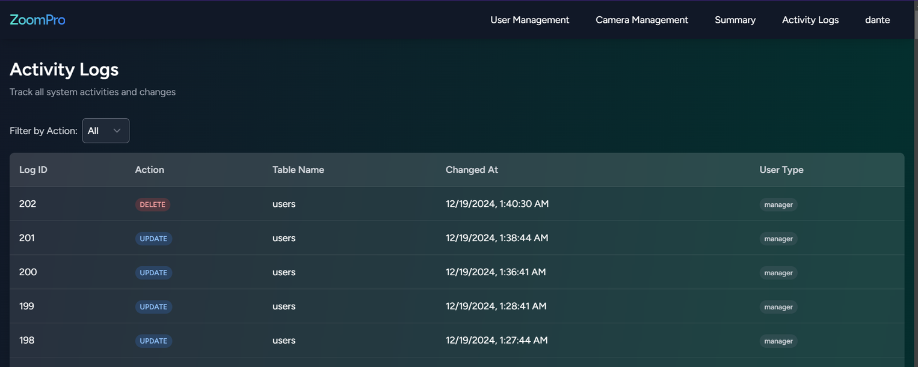
CRUD
READ
04
The manager can access the Activity Logs page to view detailed real-time records of actions performed by users. These records include activities related to user accounts, payments, and camera management, specifying whether they were updated, deleted, or inserted.

Slide 9
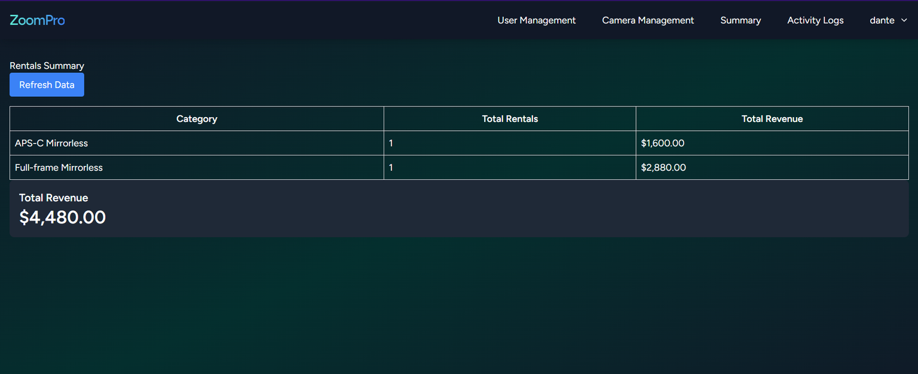
CRUD
READ
04
The manager can access the Summary page to view a comprehensive overview of all rentals made. This page provides detailed insights, including the categories of cameras, the total number of rentals for each category, and the total revenue generated.

Slide 10
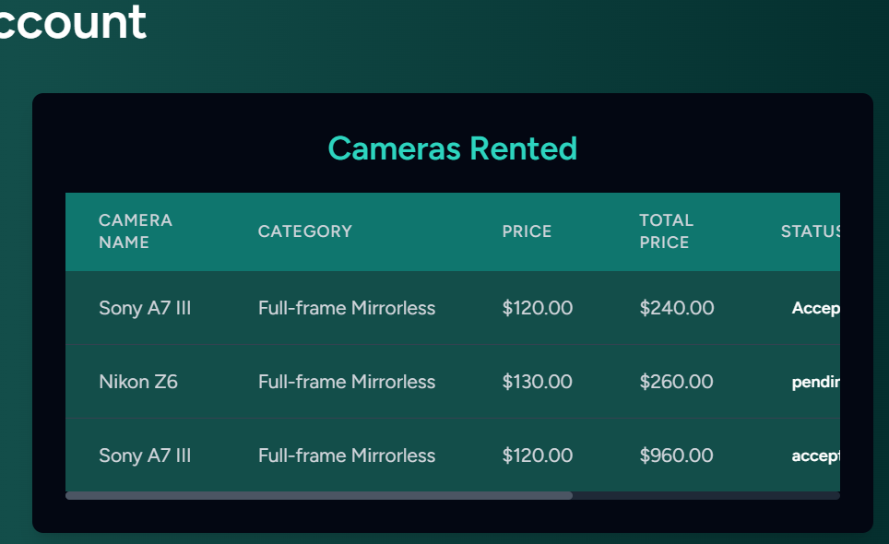
CRUD
READ
04
The customer can navigate to the Account page and view their transaction history under the "Cameras Rented" section, which displays details of the cameras they have rented.

Slide 11
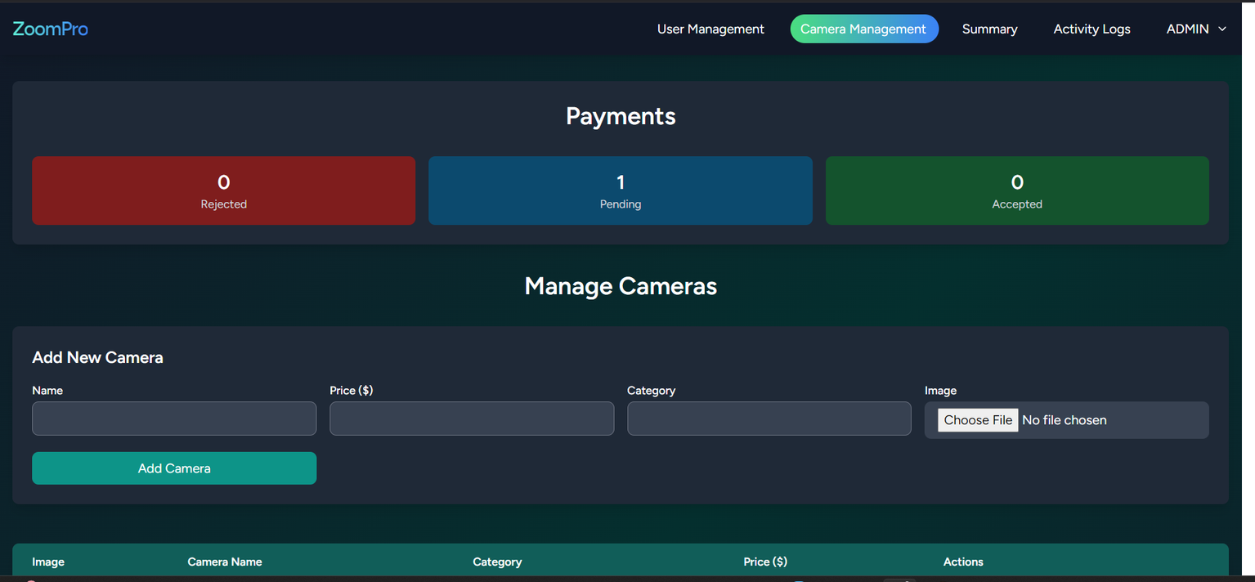
CRUD
READ
04
The manager can navigate to the Camera Management page and view the number of pending, rejected, and accepted payment transactions in the Payment section.

Slide 12
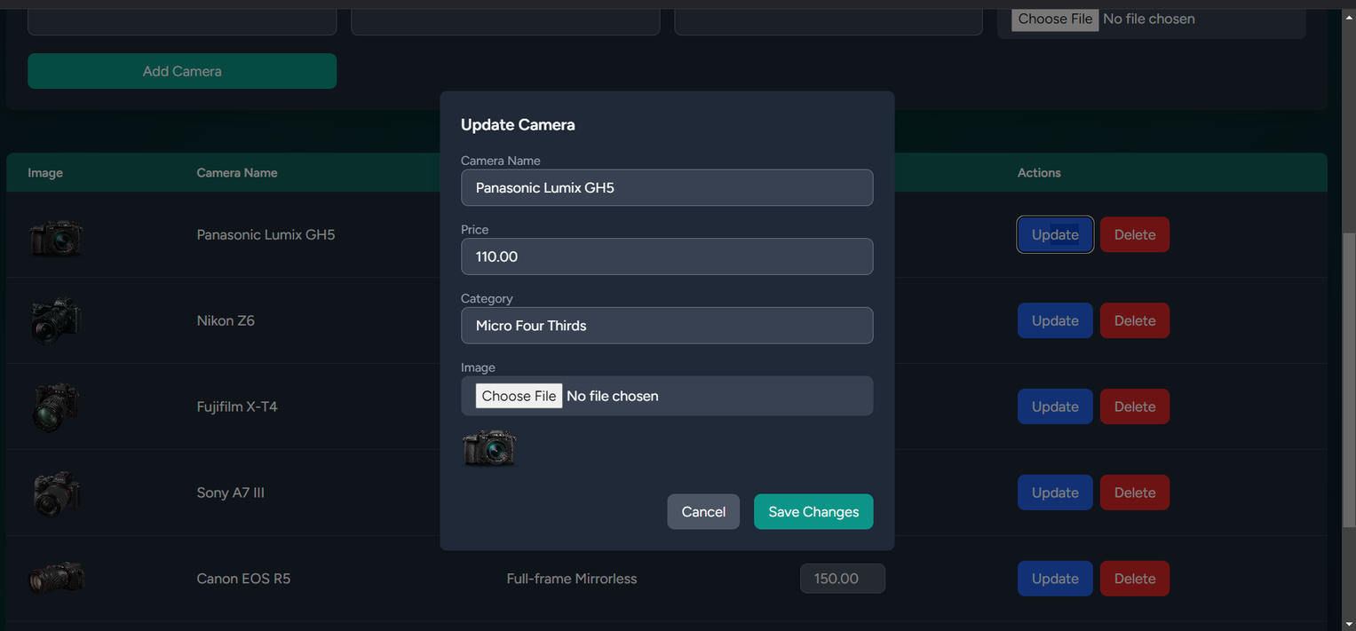
CRUD
UPDATE
04
The manager can navigate to the Camera Management page and update camera details, including the camera's name, category, and price, ensuring accurate and up-to-date information.

Slide 13
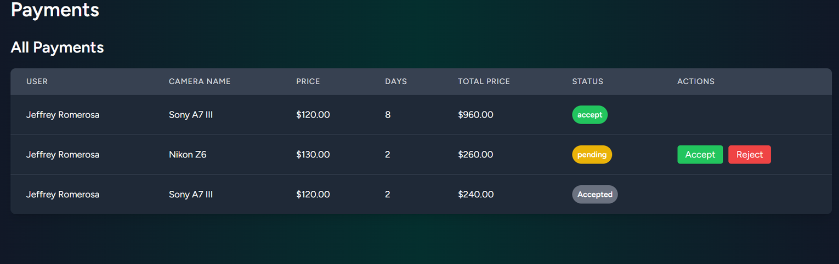
CRUD
UPDATE
04
The employee can manage pending rental transactions by either accepting or rejecting customer requests, ensuring efficient handling of rental processes.

Slide 14
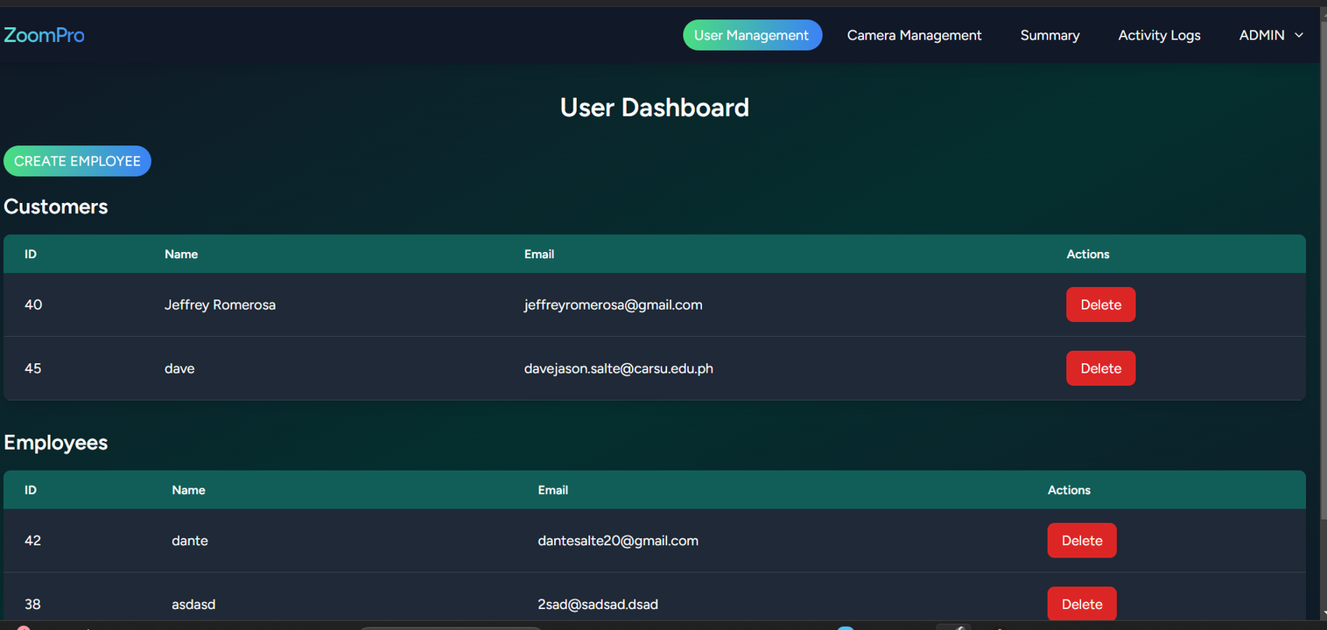
CRUD
DELETE
04
The manager can navigate to the User Management page and has the authority to delete accounts, including both customer and employee accounts, as required.

Slide 15
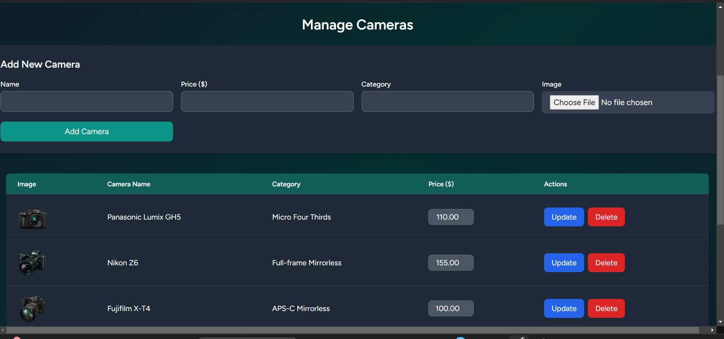
CRUD
DELETE
04
The manager can navigate to the Camera Management page and delete any selected camera from the inventory as needed.

Slide 16
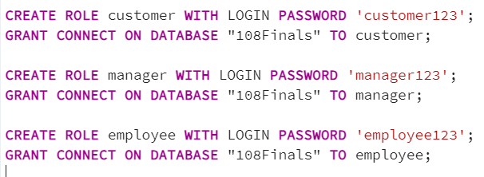
RBAC
05
For role-based access control, three distinct roles were created—Customer, Employee, and Manager—each with their respective permissions explicitly defined. These roles were granted access to interact with the database named "108Finals," ensuring secure and structured database connectivity aligned with their responsibilities.
This query updates the user's role to the desired role.

Slide 17
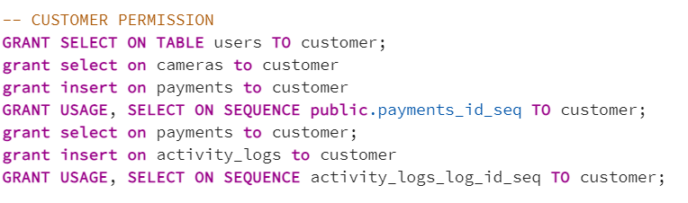
RBAC
05
Role: Customer
The privileges or permissions granted for the customer role are:
use & select from payments_id_seq sequence for generating payment IDs.
view data from payments table.
insert records into the activity_logs table.
use & select from activity_logs_log_id_seq sequence for generating activity log IDs.

Slide 18
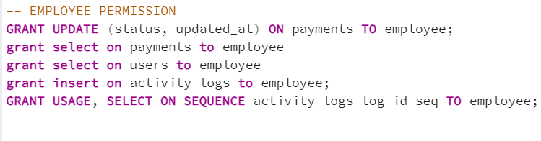
RBAC
05
Role: Employee
The privileges or permissions granted for the employee role are:
update status & updated_at columns in payments table..
view data from payments table.
view data from users table.
use & select from activity_logs_log_id_seq sequence for generating activity log IDs.
insert records into activity_logs table.

Slide 19
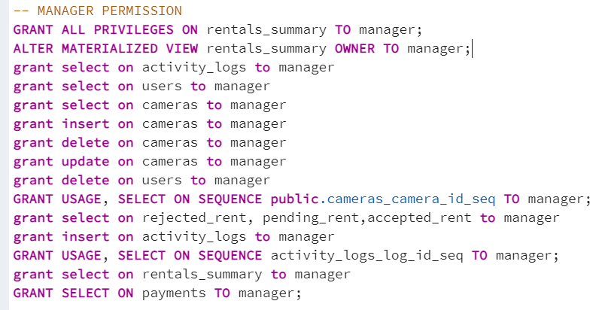
RBAC
05
Role: Manager
The privileges or permissions granted for the manager role are:
all privileges & ownership of rentals_summary
materialized view.
view data from activity_logs table.
view & delete records from users table.
view, insert, update, & delete records in cameras
table.
use & select from cameras_camera_id_seq sequence.
view data from rejected_rent, pending_rent,
& accepted_rent views.
insert records into activity_logs table.
use & select from activity_logs_log_id_seq sequence.
view data from rentals_summary table.
view data from payments table.

Slide 20
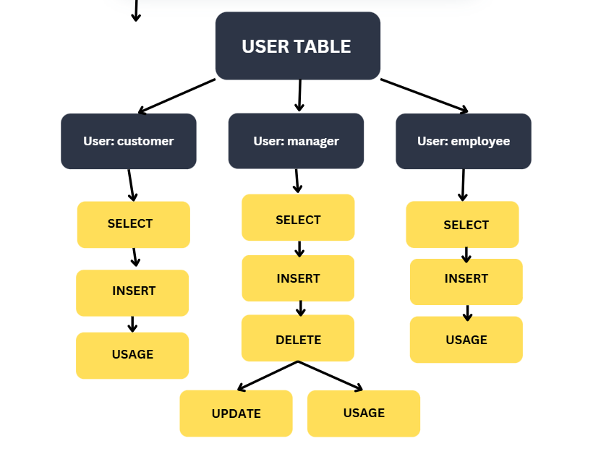
06
Role and Privileges Assignment Diagram

Slide 21

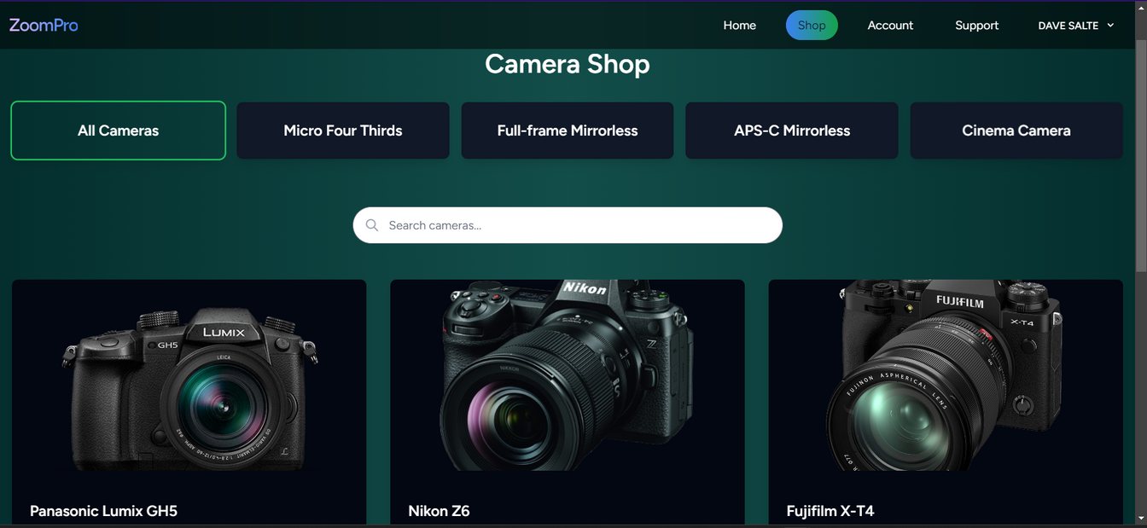
07
USER ROLES AND FEATURES
Customers:
Log in, browse cameras, and specify rental duration.
Automatically calculate and process payments.
Manage their profile (view, update, or delete).
Track the status of their rentals.

Slide 22

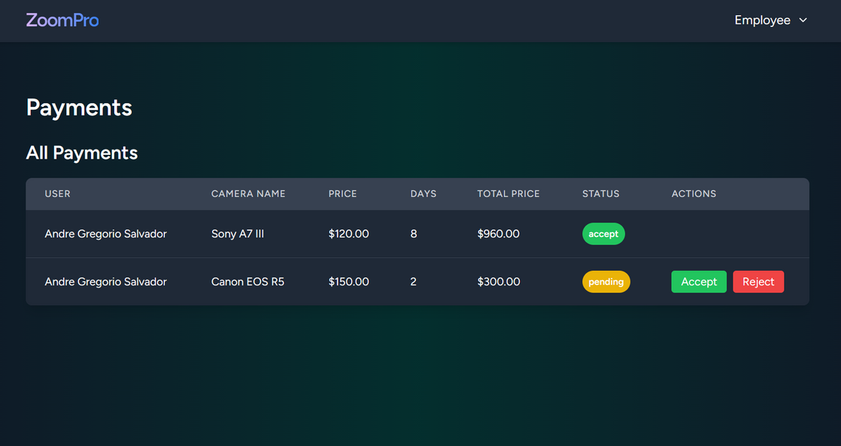
07
USER ROLES AND FEATURES
Employees:
Log in to manage rental transactions (e.g., update rental statuses).
Accept or Reject payments of customer.

Slide 23

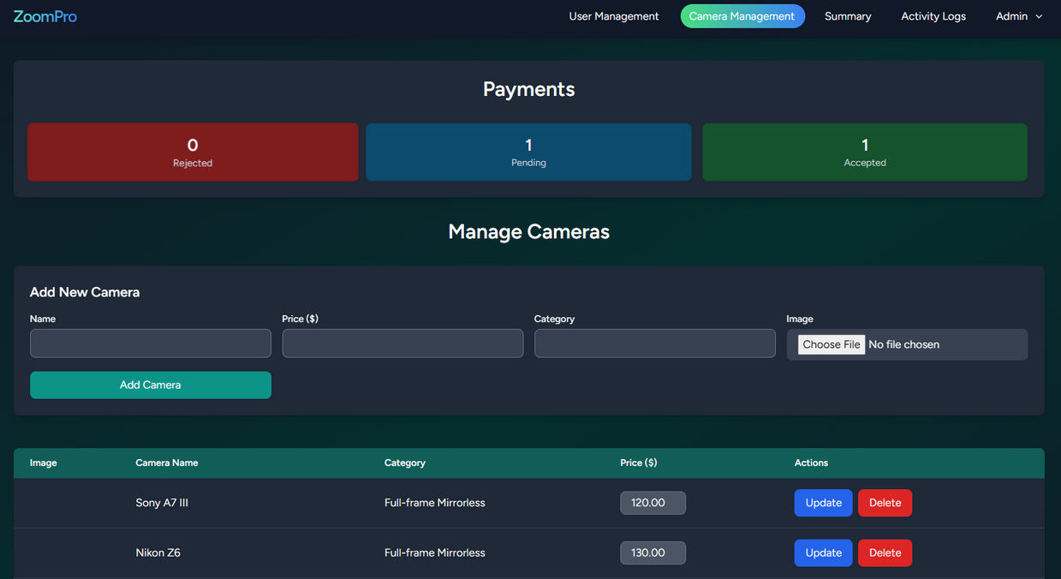
07
USER ROLES AND FEATURES
Managers:
Oversee rental transactions and manage camera inventory.
Manage user accounts (assign roles or delete users).
Generate system performance reports.
View and update their profile.

Slide 24
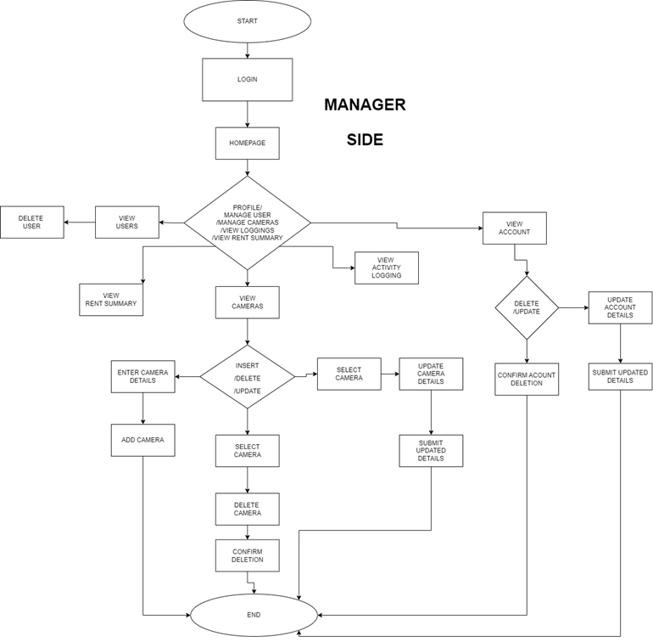

08
WORKFLOW
MANAGER

Slide 25
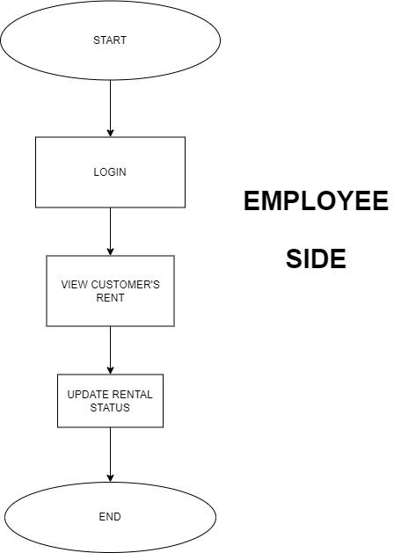
08
WORKFLOW
EMPLOYEE

Slide 26
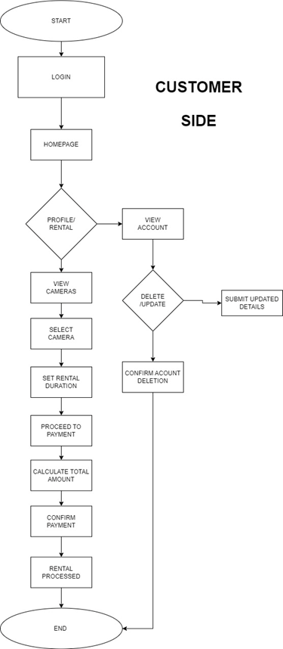
08
WORKFLOW
CUSTOMER

Slide 27
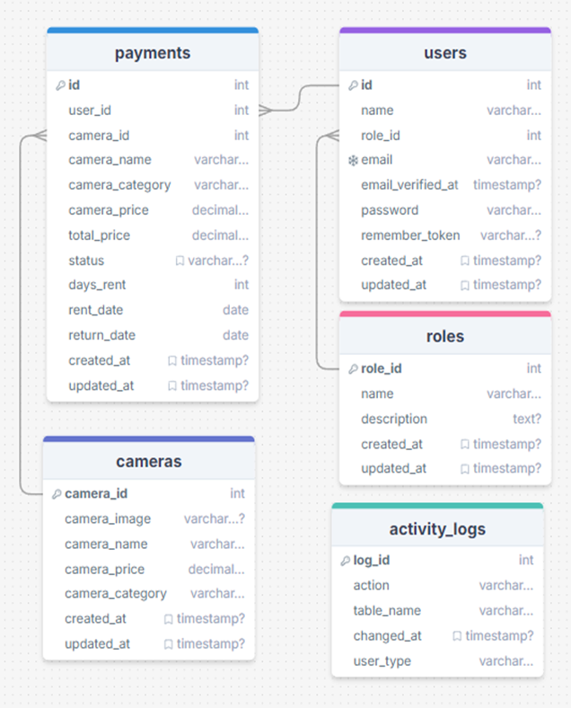

DATABASE
DESIGN
09
PAYMENTS
USERS
ROLES
CAMERAS
ACTIVITY_LOGS

Slide 28
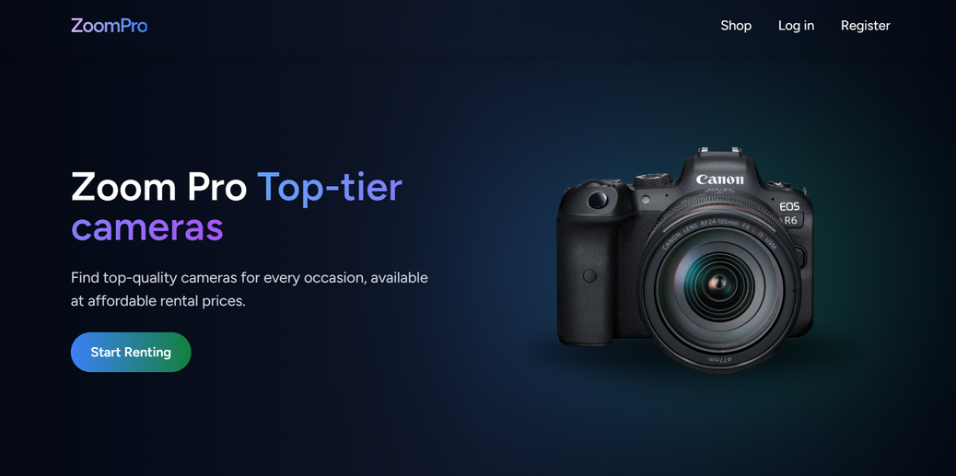
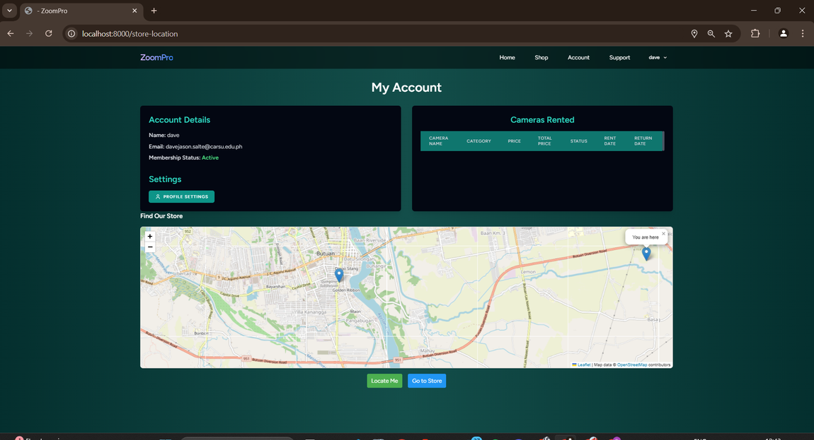
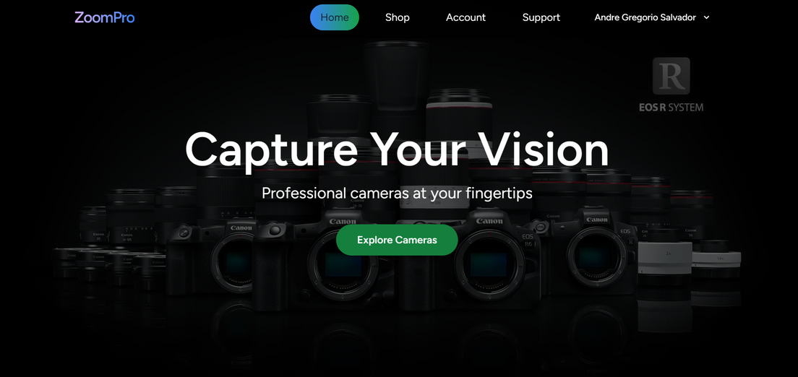
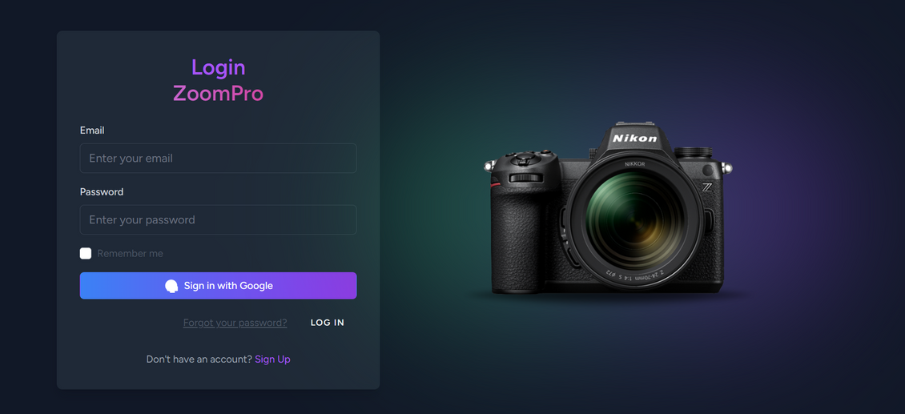
10
UI / DEMO

Slide 29
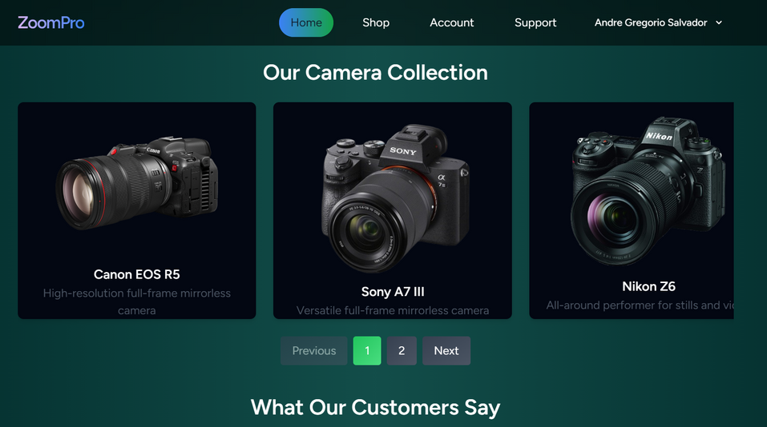
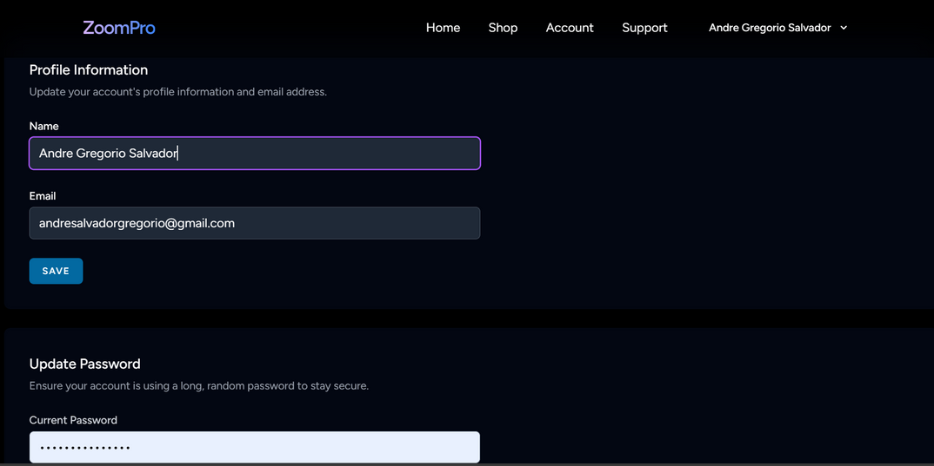
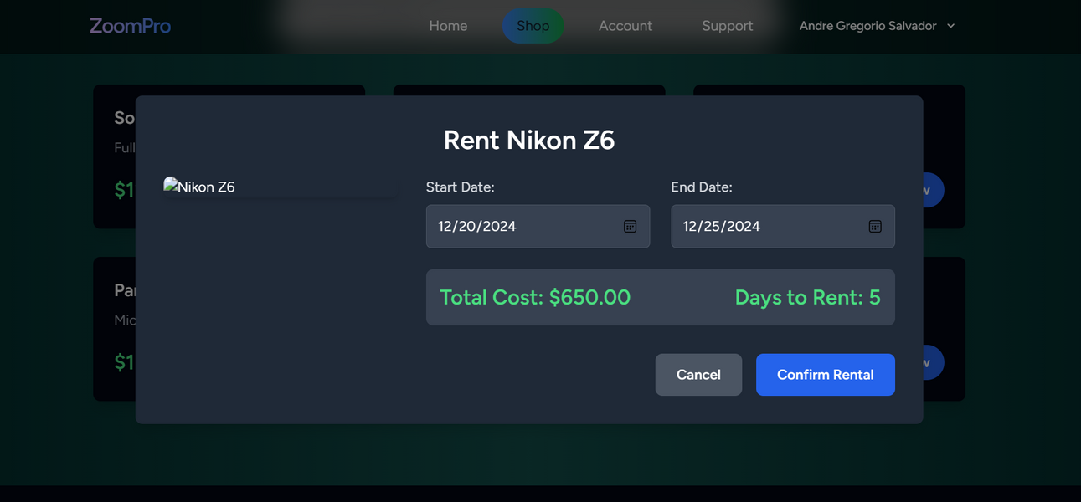
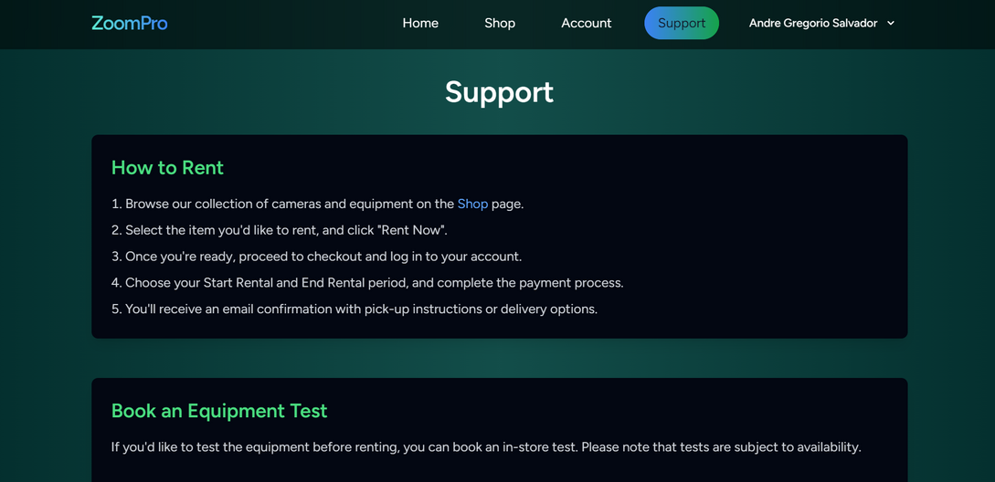

10
UI / DEMO

Slide 30




10
OUR TEAM
DAVE JASON B. SALTE
JEFFREY ROMEROSA
ANDRE G. SALVADOR

Slide 31
END OF SLIDE
THANK YOU

